Slide 1
PROJECT PRESENTATION
Monthly Expense & Budget Analyzer
Ch. Deepika Roll No: 2620090055
Shree Shree Mahaalaxmi Roll No: 2620030117
Faculty Guide: [Guide Name]

Slide 2
Introduction
Managing personal money is hard without a clear view of where it goes each month.
The Monthly Expense & Budget Analyzer is a Java application that records daily expenses, sets a monthly budget and analyzes spending.
It turns raw entries into simple summaries so users can spend smarter.
Track
Record every expense
1
Budget
Set monthly limits
2
Analyze
Compare spend vs. budget
3
2

Slide 3
Problem Statement
1
No clear tracking
2
Overspending unnoticed
Expenses are scattered across memory, notes and receipts, so nothing is recorded reliably.
Users only realise they crossed their budget after the month is over.
3
Manual calculation
4
No insight
Totals and category-wise splits take time and are prone to errors.
Without summaries, it is hard to see which category needs cutting down.
3

Slide 4
Objectives
1
Record daily expenses with date, category and amount
2
Let the user set a monthly budget
3
Calculate total spending and category-wise breakdown
4
Compare expenses against budget and flag overspending
5
Provide a simple, easy-to-use Java application
4

Slide 5
Existing System
Manual notebooks / paper
Spreadsheets / generic apps
Easy to lose or damage
Manual totals, frequent errors
No budget comparison
Need formulas and setup effort
Often cluttered with features
Little guidance on overspending
5

Slide 6
Proposed System
A lightweight Java application that automates expense tracking and budget analysis.
1
2
3
4
Fast entry
Auto totals
Budget check
Clear reports
Add expenses in seconds
Instant monthly and category sums
Alerts when spending exceeds the limit
Readable monthly summary
6

Slide 7
System Architecture
User
Java Interface
Expense Manager
Data Storage
Report
Enters data & choices
Menu / input & display
Add, validate, calculate
Expenses & budget records
Totals, categories, budget status
Layered flow: input → processing → storage → analysis output
7

Slide 8
Functionalities
1
Add Expense
2
View Expenses
3
Set Budget
Date, category, amount, note
List all recorded entries
Define the monthly limit
4
Category Summary
5
Budget Analysis
6
Monthly Report
Spending per category
Spent vs. remaining balance
Consolidated month overview
8

Slide 9
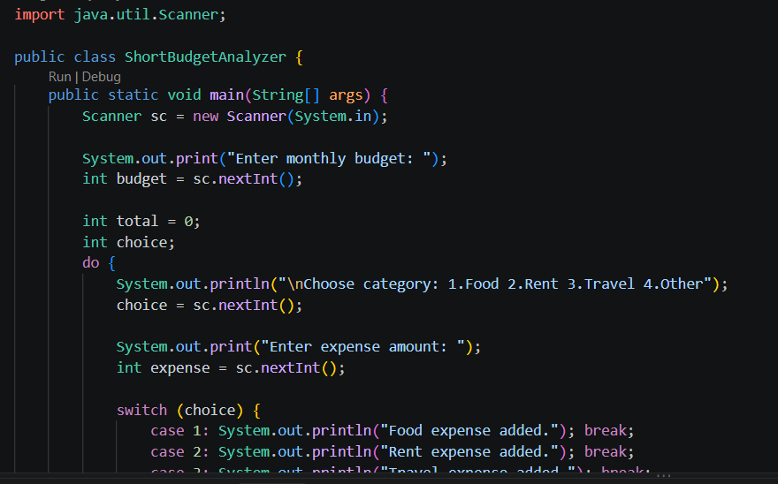
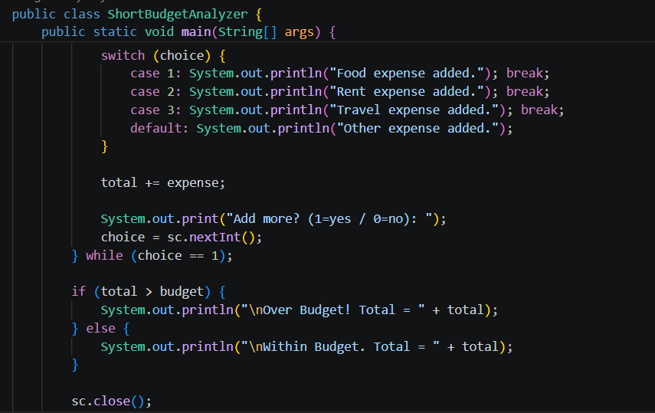
Implementation – Java Code
Paste screenshot here
Paste screenshot here
9

Slide 10
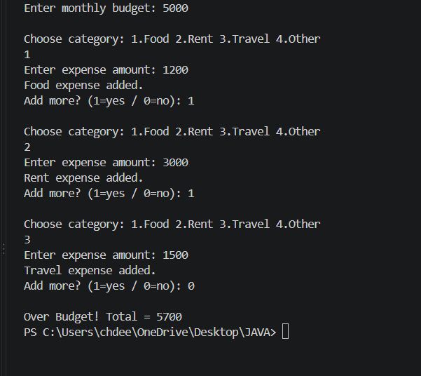
Output Screenshots
10

Slide 11
Future Scope
1
Graphical (GUI) or mobile app interface
2
Database integration for permanent storage
3
Charts and graphs for visual spending trends
4
Multi-user login with secure accounts
5
Smart alerts and savings suggestions
11

Slide 12
Conclusion
The Monthly Expense & Budget Analyzer makes expense tracking simple and accurate.
It helps users stay within budget through automatic totals and analysis.
Built in Java, it can be extended with a GUI, database and charts.

Slide 13
Thank You
Questions?
Ch. Deepika (2620090055) | Shree Shree Mahaalaxmi (2620030117)

